Slide 1
CLASS 7 – 12.07.2021 | FINALE
Player Analytics IV – Soccer Analytics
Final – Due SATURDAY 11:59pm ET | GROUP
Guest Speaker:
Oliver Miller-Farrell
Director of Strategy and Analytics, Nashville SC
Breaks: 5:30pm (5 mins) | 6:05pm (10 mins)

Slide 2
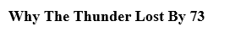
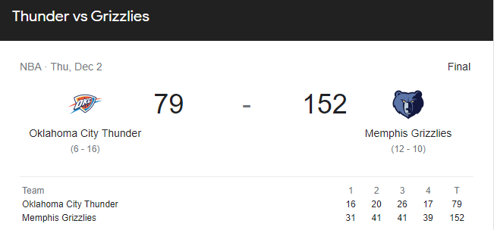
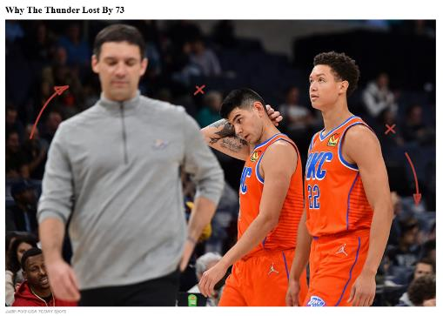
News from the past week
The Thunder made history — and not the kind you want to see in the record books.
OKC lost to the Grizzlies by 73 points last night — the largest loss in league history by five points.
The Thunder have reached a low unseen even during Philly GM Sam Hinkie’s infamous “Process,” but the formula is awfully similar.
Thunder GM Sam Presti went full rebuild after 2020’s first-round playoff exit — starting his own process of trading superstars for promising young talent and a stockpile of draft picks.
In November 2020, Presti traded Chris Paul to the Suns for four role players and a first-round pick.
The same month, he traded Steven Adams and Eric Bledsoe to the Pelicans for a first- and second-round pick.
In December 2020, OKC traded Paul George to the Clippers for Shai Gilgeous-Alexander, Danilo Gallinari, and five first-rounders.
With tons of cap space ($24.6M) and a core of SGA, Luguentz Dort, and rookie Josh Giddey, the Thunder have accumulated a total of 36 draft picks over the next five years — 19 first-rounders and 17 second-rounders.
Their $79.1 million payroll is by far the lowest in the NBA — a staggering $36 million less than the second-lowest Grizzlies.
If they draft properly the way they did with Rookie of the Month Giddey, then they should be good — a very long time from now.

Slide 3
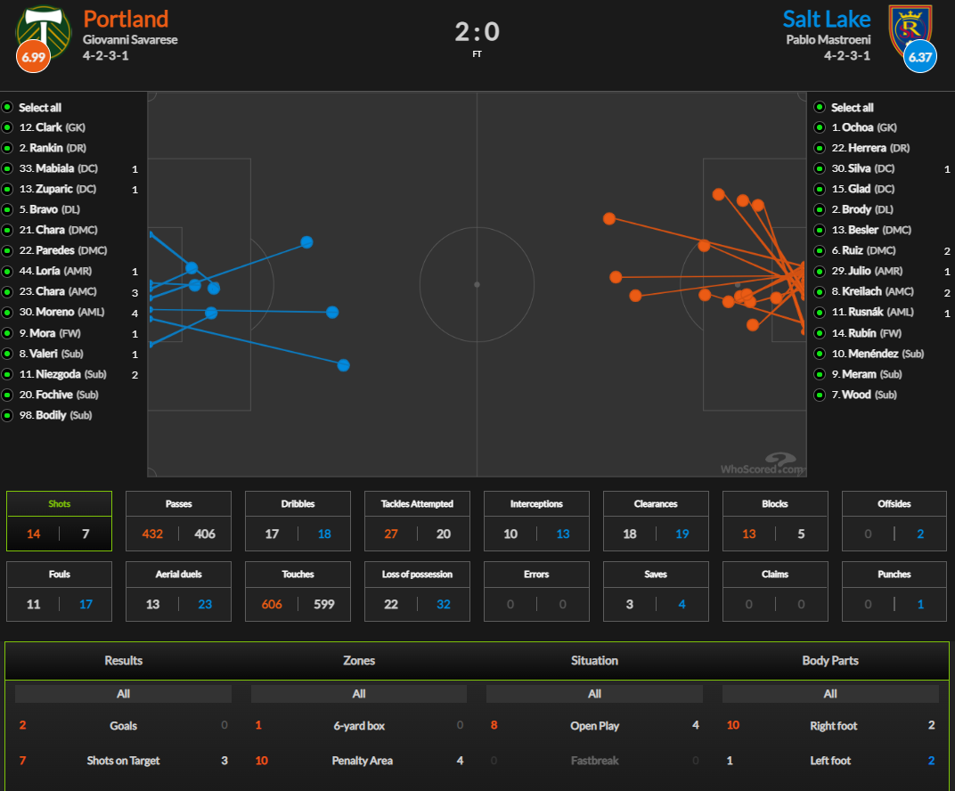
MLS Cup – Western Conf. Finals
Notes:
https://www.whoscored.com/Matches/1602995/Live/USA-Major-League-Soccer-2021-Portland-Timbers-Real-Salt-Lake

Slide 4
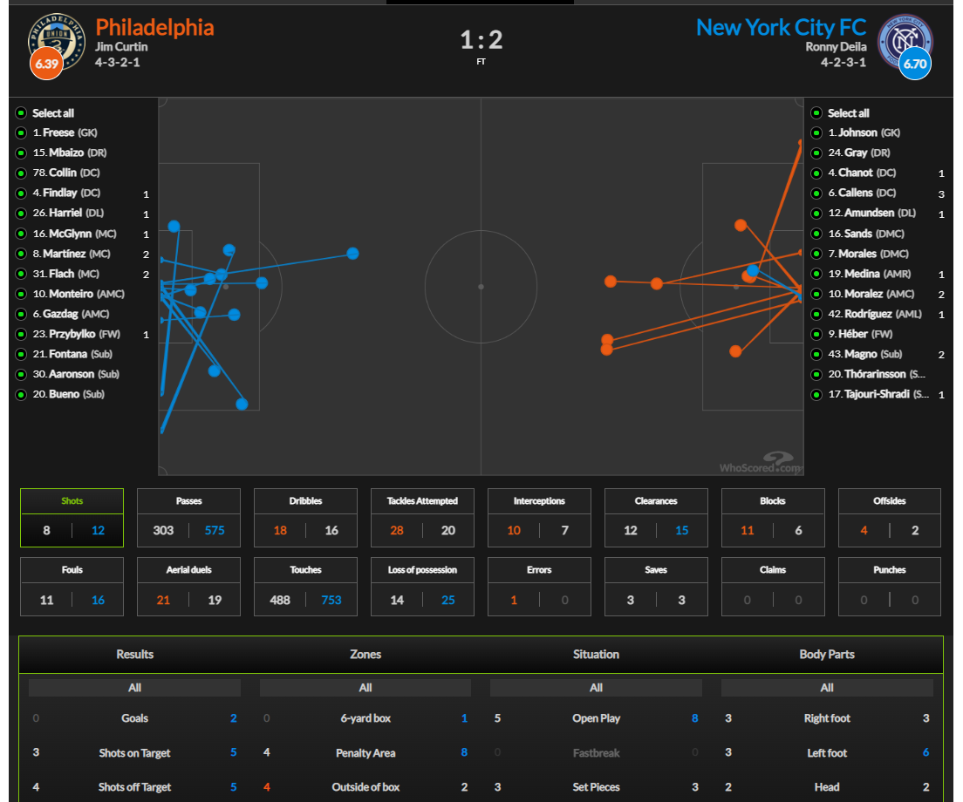
MLS Cup – Eastern Conf. Finals
Notes:
https://www.whoscored.com/Matches/1603104/Live/USA-Major-League-Soccer-2021-Philadelphia-Union-New-York-City-FC

Slide 5
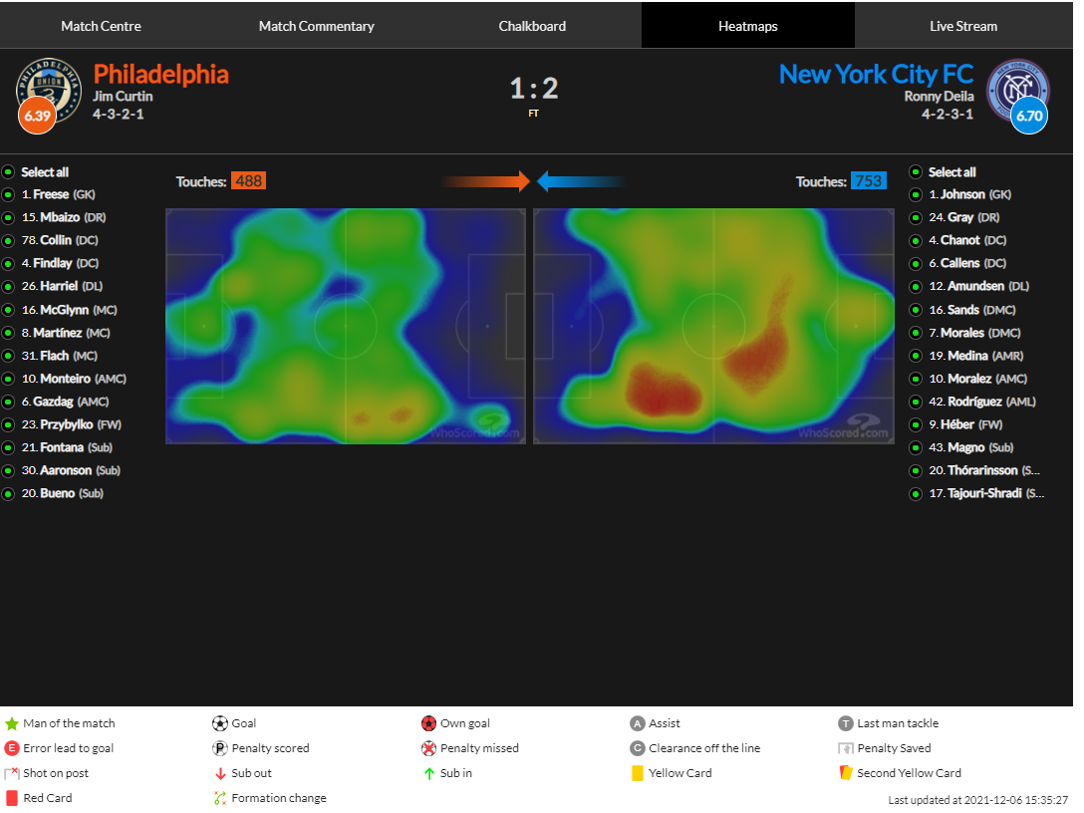
MLS Cup – Eastern Conf. Finals
Notes:
https://www.whoscored.com/Matches/1603104/Live/USA-Major-League-Soccer-2021-Philadelphia-Union-New-York-City-FC

Slide 6
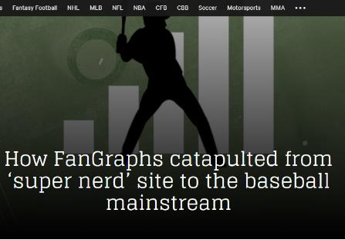
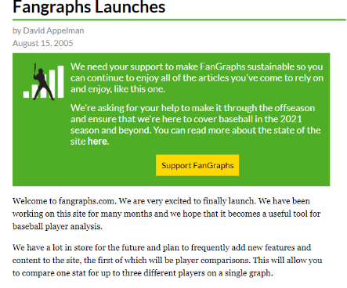
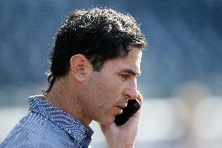
MLB Hires – former FanGraphs writers:
* Dave Cameron – SD Padres, Analyst/Special Asst. to the GM
* Kiley McDaniel – Atlanta Braves
* Corinne Landrey – Philadelphia Phillies
* August Fagerstrom – Milwaukee Brewers
* Carson Cistulli – Toronto Blue Jays
* Jeff Sullivan – Tampa Bay Rays
(San Diego Padres general manager A. J. Preller in 2019: Alex Gallardo / Associated Press)
Notes:
https://theathletic.com/2229556/2020/12/04/fangraphs-baseball-writing-data-analytics/?utm_source=SportTechie_Newsletter&utm_medium=Email&utm_campaign=SportTechie+Daily

Slide 7
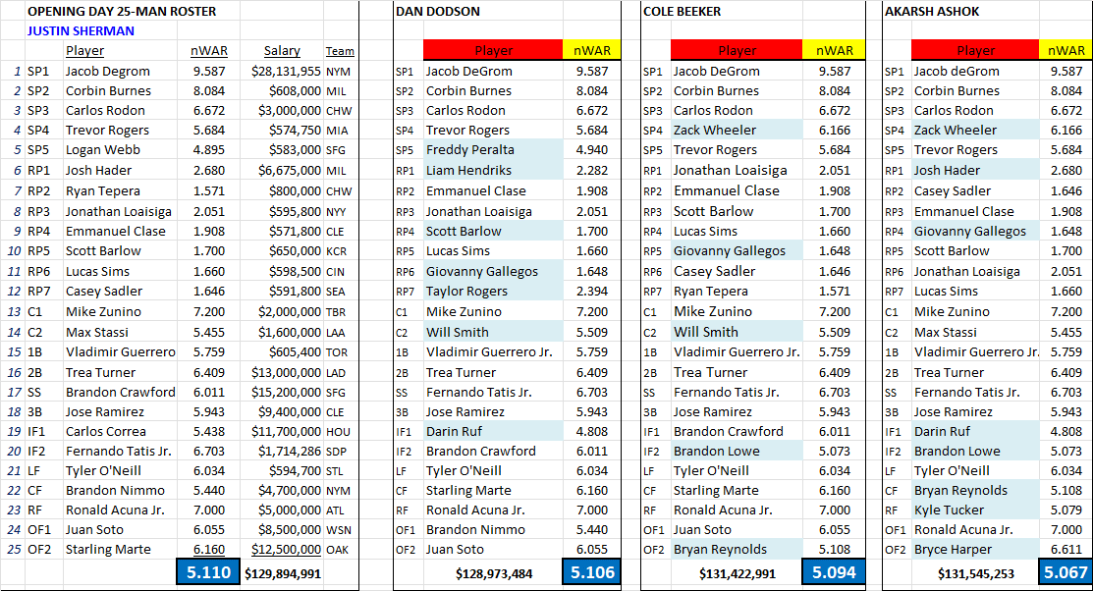
Assignment 3 – Top 4

Slide 8
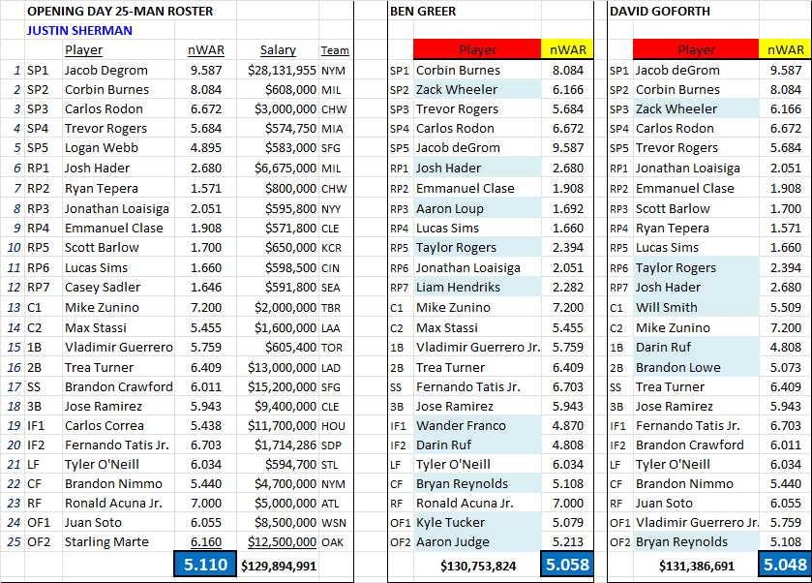
Assignment 3 – Top 5-6
Also over 5.0: Mouritzen, Sanchez, Herman

Slide 9
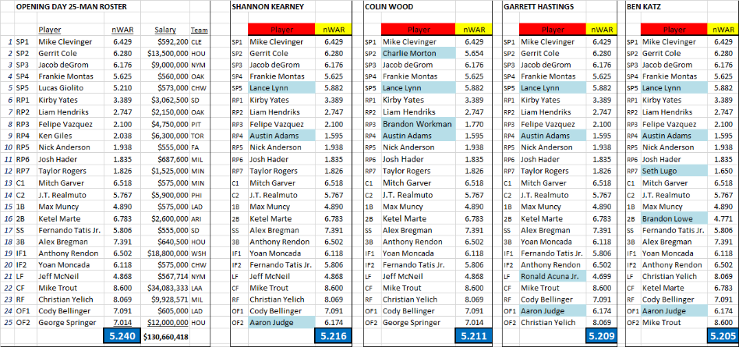
Assignment 3 – Opening Day 25-man Roster {2020}
{Tableau}
Notes:
Ask 3 students for their approach. Then switch to Tableau

Slide 10
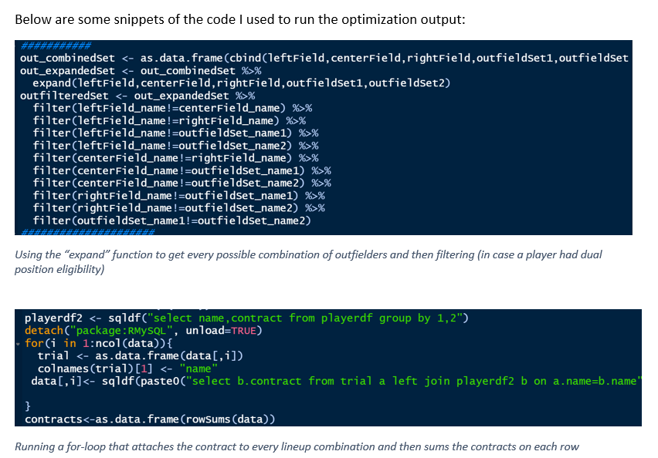
Assignment 3 – Methods – Justin Sherman
fantasy basketball optimization code in R studio

Slide 11
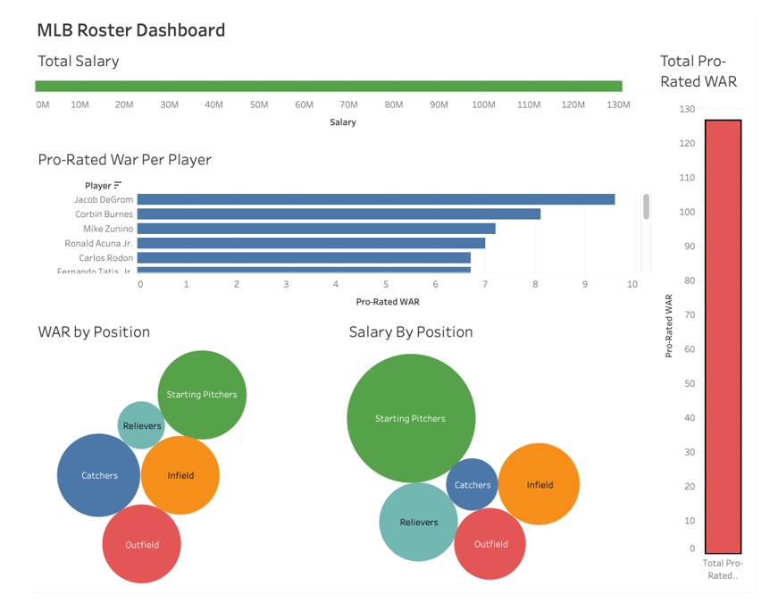
Assignment 3 – Methods – Ben Greer

Slide 12
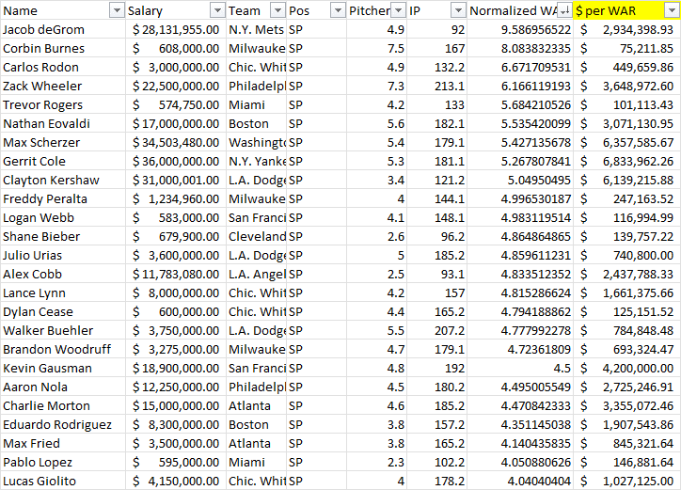
Assignment 3 – Methods – David Goforth
$/WAR approach

Slide 13
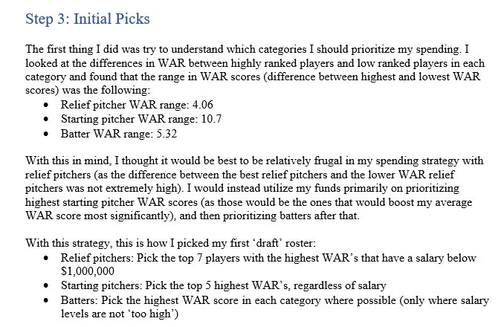
Assignment 3 – Methods – Yasir Mohammed

Slide 14
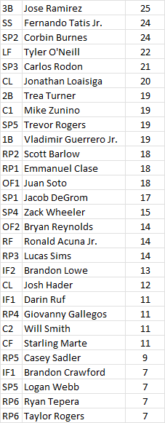
Assignment 3 – Player notes
123 different players chosen
58 players selected by more than 5 teams
50 selected by only one team
Bryce Harper: 5 teams ($27M+ salary)

Slide 15
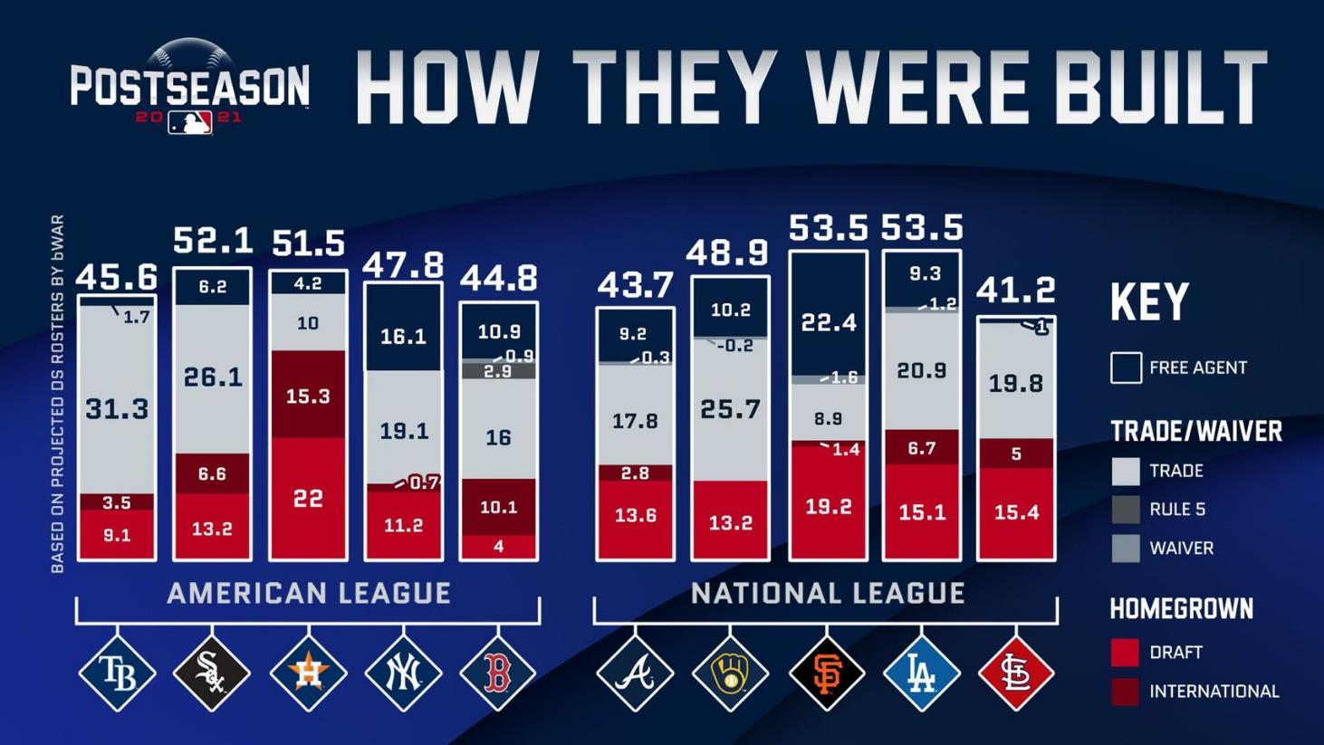

Slide 16
Player Analytics
11/16 – Baseball |
11/23 – Soccer | Momin Ghaffar, Jaguars
11/30 – Basketball | Kevin Tenenbaum, Cle MLB
12/7 – Hockey | Oliver Miller-Farrell, Nash SC
KEY TAKEAWAYS:
How has the sport evolved: Basic vs. Advanced Stats
Offense vs. Defense
End-all Be-all | One all encompassing stat? WAR

Slide 17
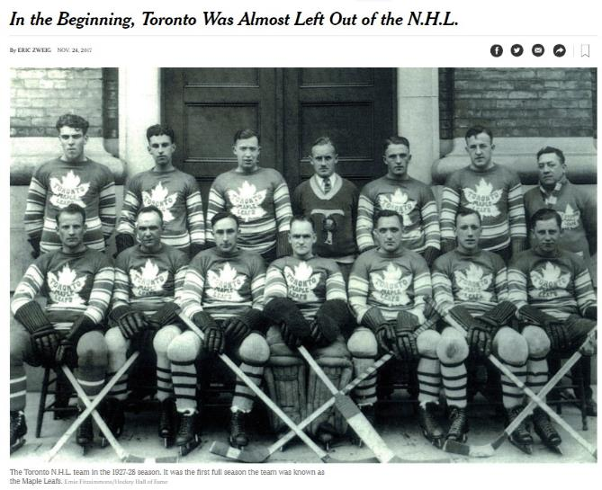
Nat’l Hockey Assoc. (NHA) – 1909-1917
NHL - Founded Nov. 26, 1917 –
4 teams in Canada
‘24: Boston
’26: NY Rangers, Chicago, Detroit
“Original Six”
Notes:
NHL turns 100 - https://www.nytimes.com/2017/11/24/sports/hockey/nhl-centennial-toronto-maple-leafs-history.html

Slide 18
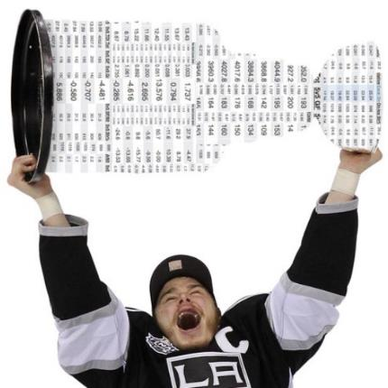
“The 2014-15 season marks the start of the NHL’s Age of Analytics” – NYT 10/8/14
Traditional Stats:
* Goals/Assists
* Saves
* Goals Against Avg. (GAA)
* +/- (‘67-’68)
* Shots (‘82-’83)
New Stats:
* Corsi
* Fenwick
* PDO
* Zone Starts
* Qual Comp
Determine which players best match up against opponents and increase a team’s chances of winning
Notes:
http://www.nytimes.com/2014/10/08/sports/hockey/far-from-days-of-original-six-nhl-adopts-complex-numbers.html?_r=2

Slide 19
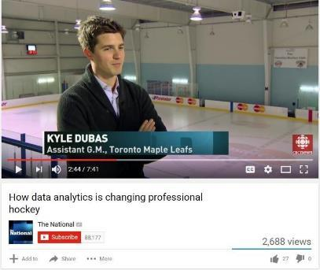

Hockey – the final frontier
Hired at Age 24
Named GM on 5.11.18 at age 32
https://www.youtube.com/watch?v=mq3v8fN1x8k
Notes:
https://www.youtube.com/watch?v=mq3v8fN1x8k - Mute at 4:52

Slide 20
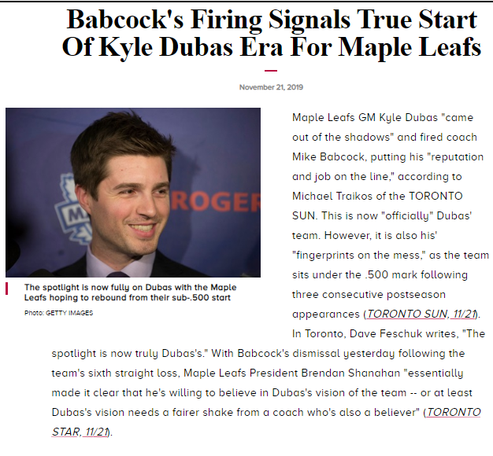

Slide 21
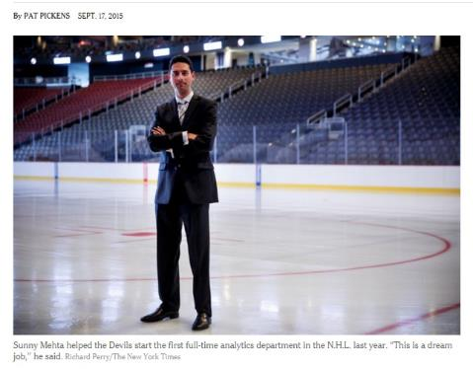
Moneypuck Era begins (10.4.14)
This summer, the NHL burst into its information age, poaching statistical gurus and bloggers from their Web sites and paying them to work behind the curtain. The numbers had become more digestible, the information available everywhere. Ignoring it meant falling behind.
* Edmonton Oilers: Tyler Dellow – mc79hockey.com
* Toronto Maple Leafs: Darryl Metcalf – Extraskater.com
* NJ Devils: Sunny Mehta – pro poker player & hockey stats blogger. First full-time nhl team analytics director
Left the Devils in Nov. 2017
Currently the Vice President of Hockey Strategy and Intelligence for the Florida Panthers
Notes:
http://www.washingtonpost.com/sports/nationals/playoffs/although-stats-gurus-are-slowly-finding-a-place-in-the-nhl-caps-believe-in-a-combination-of-feel-and-numbers/2014/10/04/39ec5060-4b5c-11e4-891d-713f052086a0_story.html
http://www.nytimes.com/2015/09/18/sports/devils-go-all-in-on-analytics-ex-poker-pro-helps.html

Slide 22
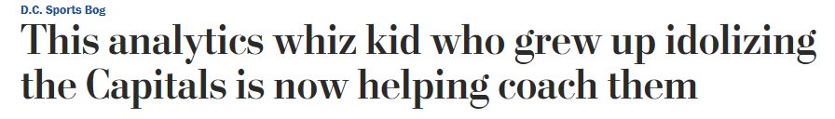
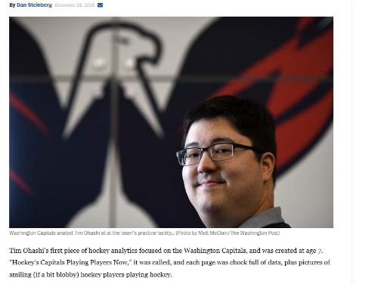
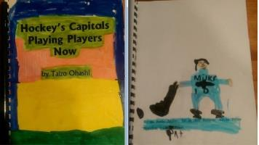
Started as in intern in 2014
Attends every game
Delivers video reports to players
Breaks down every penalty
Pre-scouts/analyzes opponents - “Coach Ohashi Stat of the Day”
Ran Caps’ game video-review operation - responsible for calling back two offside goals scored against the Caps in overtime games they eventually won: last year against Boston and this year against Buffalo
Notes:
https://www.washingtonpost.com/news/dc-sports-bog/wp/2016/12/28/this-analytics-whiz-kid-who-grew-up-idolizing-the-capitals-is-now-helping-coach-them/?utm_term=.5e12ffe59d44

Slide 23
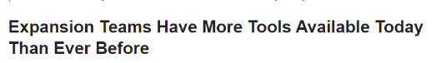
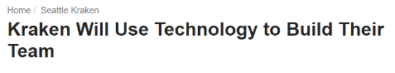
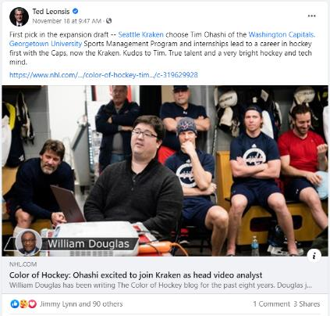

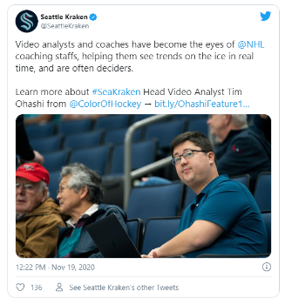
Notes:
https://www.nhl.com/news/color-of-hockey-tim-ohashi-joins-seattle-kraken/c-319629928
https://thehockeywriters.com/kraken-team-building-video-analysis-importance/

Slide 24
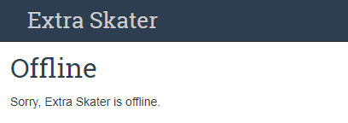
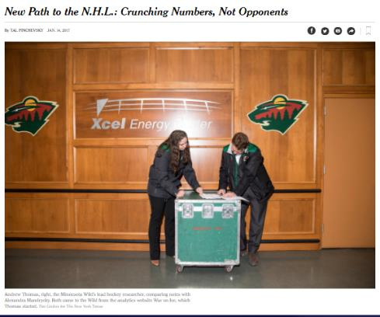
Hockey Analytics Hires
Toronto – Darryl Metcalf
ExtraSkater.com
War-On-Ice.com
Pitt: Sam Ventura
Minn: Andrew Thomas &
Alexandra Mandrycky
Vegas – Tom Poraszka
GeneralFanager.com
Florida – Richard Pollock
IllegalCurve.com
Notes:
https://www.nytimes.com/2017/01/14/sports/hockey/new-path-to-the-nhl-crunching-numbers-not-opponents.html

Slide 25
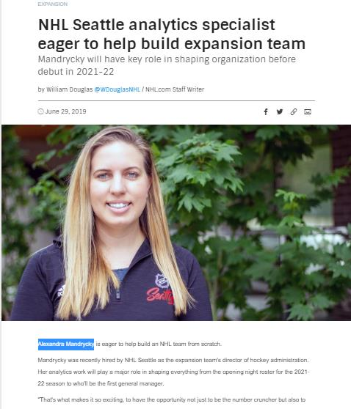

Slide 26
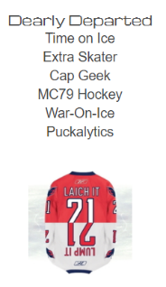
Independent NHL Stat sites
Puck on Net - http://puckon.net
Hockey Stats: http://hockeystats.ca/
Hockey-Reference: www.hockey-reference.com
Nice Time on Ice: http://www.nicetimeonice.com/
Natural Stat Trick: http://naturalstattrick.com/
Puckalytics: http://puckalytics.com/ (2017)
War On Ice: http://war-on-ice.com(2016)
Stats.HockeyAnalysis.com - (2017)
http://stats.hockeyanalysis.com/ratings.php
Fenwick-Stats (2018)
Notes:
http://stats.hockeyanalysis.com/ratings.php
http://stats.hockeyanalysis.com/ratings.php?disp=1&db=201415&sit=5v5&pos=skaters&minutes=50&teamid=0&type=individual&sort=icorsi&sortdir=DESC

Slide 27
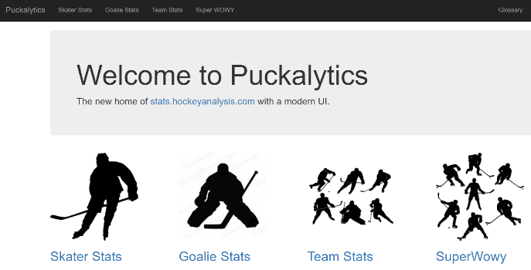
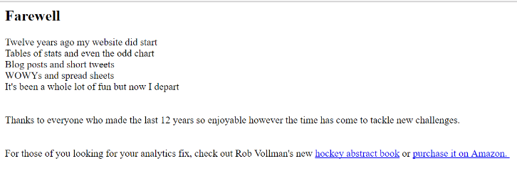
Notes:
http://puckalytics.com/#/

Slide 28
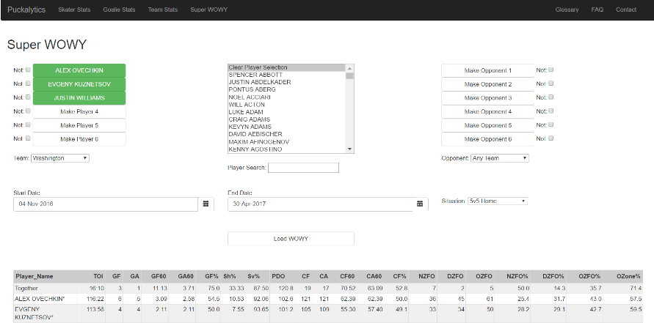
Super WOWY – launched March, 2015
WOWY = With or Without You: measures what a player's statistics when he is playing with certain teammates, as well as what those same stats look like away from them.
http://puckalytics.com/#/
Notes:
http://www.russianmachineneverbreaks.com/2015/03/10/fun-with-super-wowy-the-best-caps-lines-possible/

Slide 29
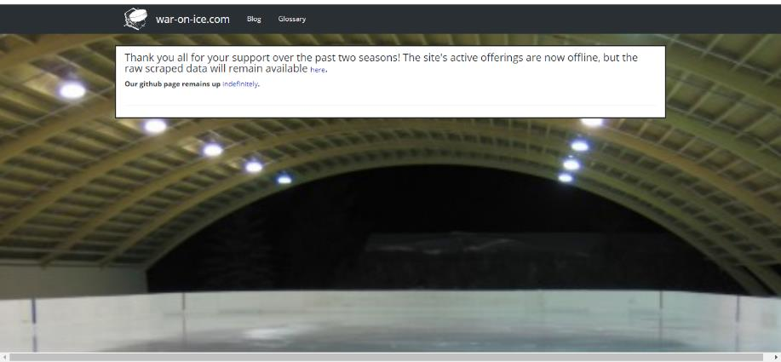
Notes:
http://war-on-ice.com/

Slide 30
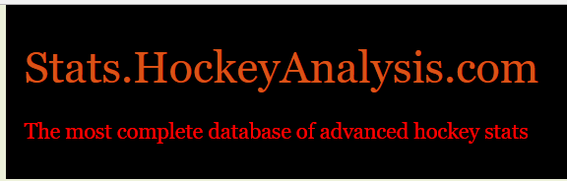
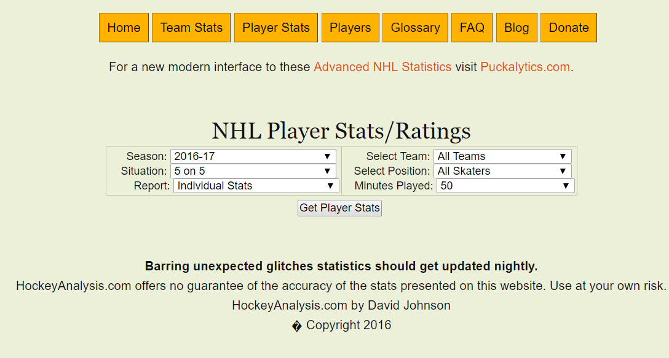
Notes:
http://stats.hockeyanalysis.com/ratings.php - show UI, glossary

Slide 31
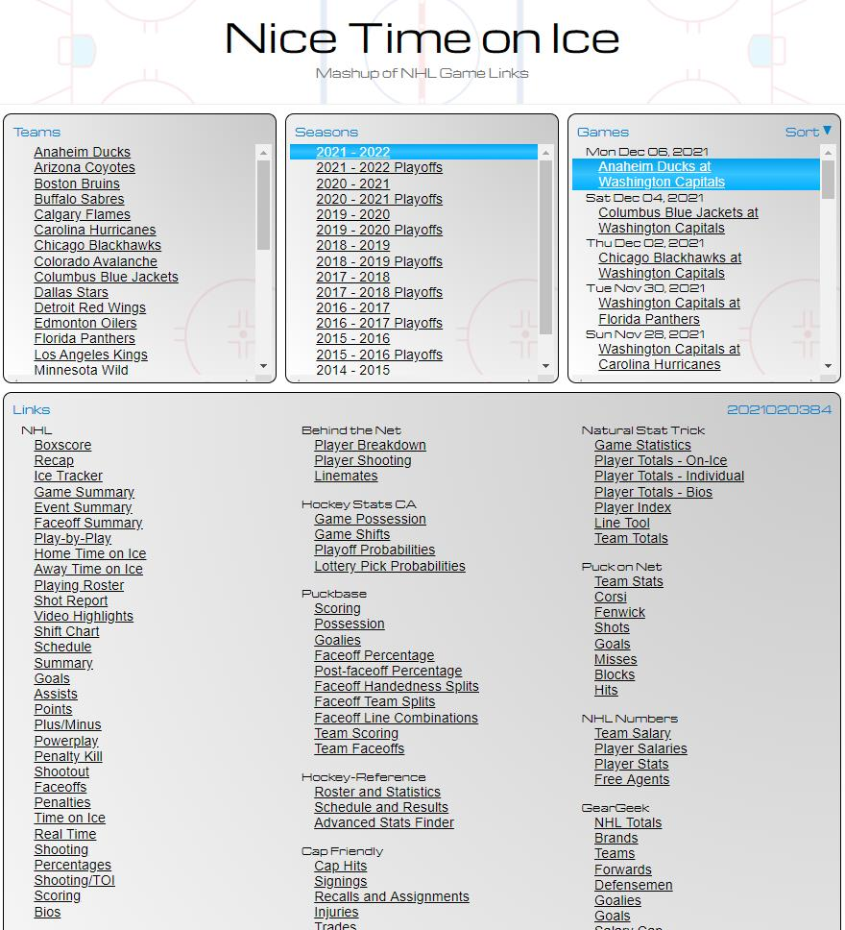
http://www.nicetimeonice.com/

Slide 32
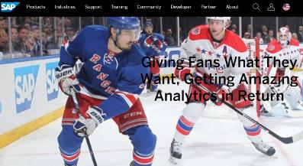
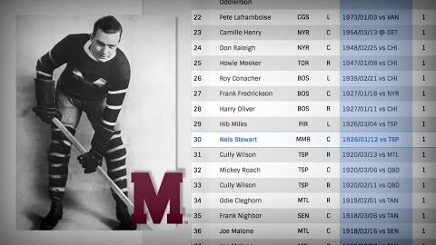
NHL.com/Stats ( 2017)
Six years. It took six year to digitize the complete statistical archive of 100 years of hockey. NHL.com/stats has the digits for every NHL game ever played.
Notes:
http://www.nhl.com/stats/leaders

Slide 33
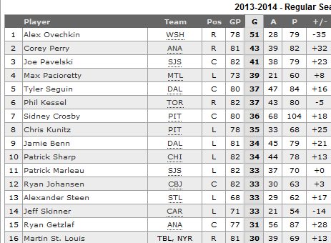
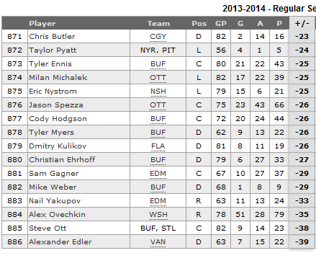
Traditional stats: Goals | +/- Ovie nearly does the unthinkable
Notes:
http://www.nhl.com/ice/playerstats.htm?fetchKey=20142ALLSASALL&viewName=summary&sort=plusMinus&pg=30

Slide 34
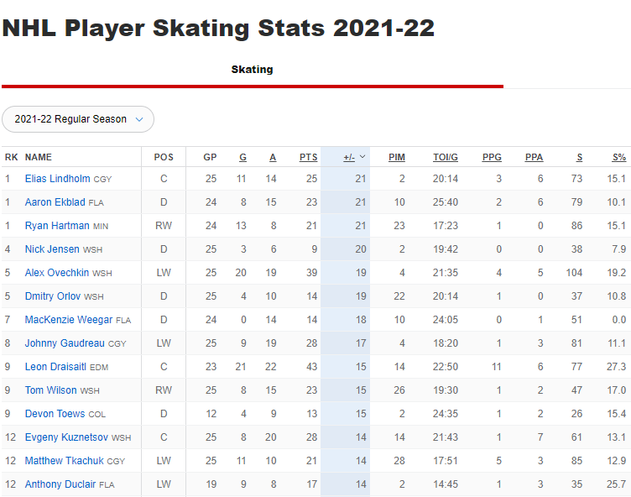

Slide 35
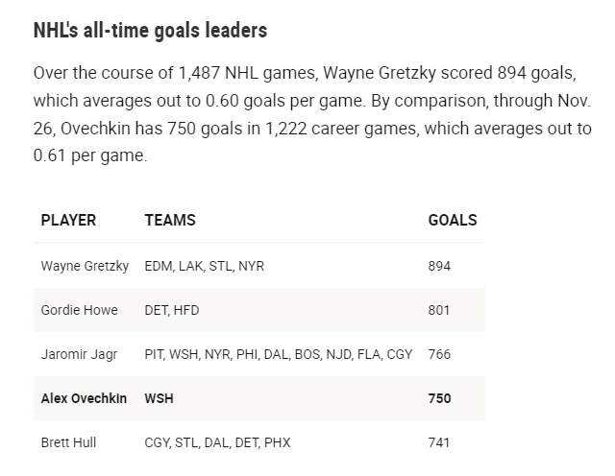

Slide 36
ADVANCED/POSSESSION STATS: Corsi – impact of a player on scoring chances
Shot attempts made by a player’s team at even strength while he is on the ice, minus the opponents’ even-strength attempts while he is on ice.
Developed by Washington Capitals analytics consultant Tim Barnes.
Named for Jim Corsi, the Buffalo Sabres goalie coach in the late 1990s, it is considered an indication of how well a player helps his team possess the puck. In 2015, the Capitals Alex Ovechkin led the league with a plus 23.04 Corsi/60 number (467 total).
Notes:
http://www.nytimes.com/2014/10/08/sports/hockey/far-from-days-of-original-six-nhl-adopts-complex-numbers.html?_r=2

Slide 37
Fenwick
The same as Corsi, but with blocked shots excluded. Some believe that having a shot blocked is a loss of possession and should not be counted as a positive act. Devised by, and later named for, Matt Fenwick of the blog Battle of Alberta, this is another statistic that reflects the value of puck possession. The Cup champion Kings led the N.H.L. four seasons ago in both Corsi and Fenwick. IN 2015, the NY Islanders led the league in Fenwick.
Notes:
http://stats.hockeyanalysis.com/ratings.php?disp=1&db=201415&sit=5v5&pos=skaters&minutes=50&teamid=0&type=individual&sort=icorsi&sortdir=DESC

Slide 38
Other stats
PDO The sum of a team’s save percentage and its shooting percentage, which is based on the number of goals scored out of the number of shots on goal. Named for Brian King’s online handle. He suggested the formula in a comment on a statistics blog using his Internet alias, PDO, the stat is seen as an expression of luck. This statistic regresses strongly to the mean over time. If a team has an early-season PDO more than 100, it has scored (or prevented) more goals than percentages say it should. Almost invariably, such teams fall back to earth; the reverse holds for teams with early PDOs less than 100. The stat can also be used for individuals.
ZONE STARTS How often a player starts his shift in a particular zone, and the best indication of how a coach uses a player. In 2015, the Blackhawks star Patrick Kane started 69.8 percent of his shifts in the offensive zone; Rangers center Dominic Moore started just 25.1 percent of his shifts in the offensive zone, reflecting a more defensive role.
QUAL COMP (QoC) Quality of competition records the combined Corsi ratings of every opponent a player faces while he is on the ice. It shows whom coaches trust the most against the other team’s best. Defensemen Ryan McDonagh (.095) and Dan Girardi (.092) consistently record the highest QoC figures on the Rangers; in Toronto, it is Dion Phaneuf (.134); with Phoenix, Oliver Ekman-Larsson (.118); in Boston, Zdeno Chara (.097).
Notes:
http://www.nytimes.com/2014/10/08/sports/hockey/far-from-days-of-original-six-nhl-adopts-complex-numbers.html?_r=2

Slide 39
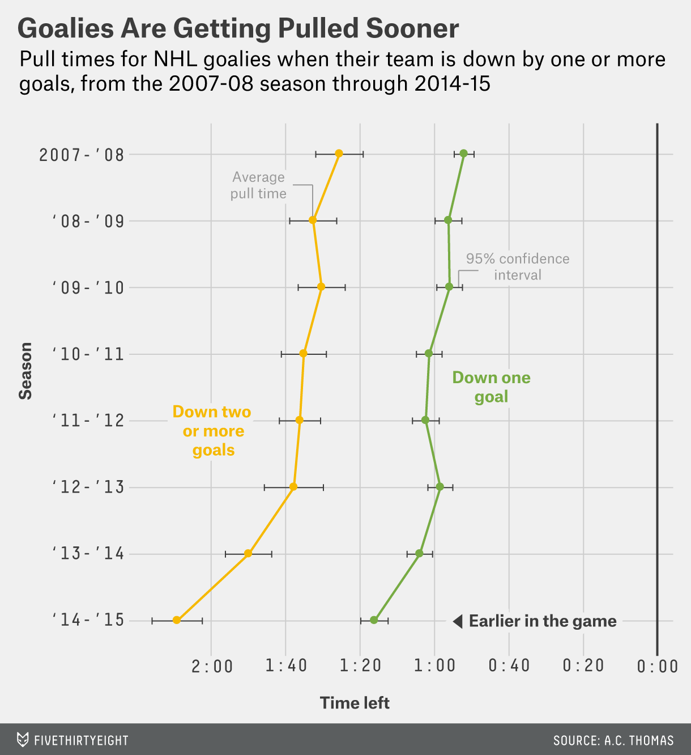
If you pull the goalie with two and a half minutes to go, you have a 19 to 20 percent chance of tying the game,” Morrison said when we called him last month. If a coach waits until the minute mark, the chances drop to 17 percent.
- Stanford Ph.D. Donald Morrison, 1976
Notes:
https://fivethirtyeight.com/features/nhl-coaches-are-pulling-goalies-earlier-than-ever/

Slide 40
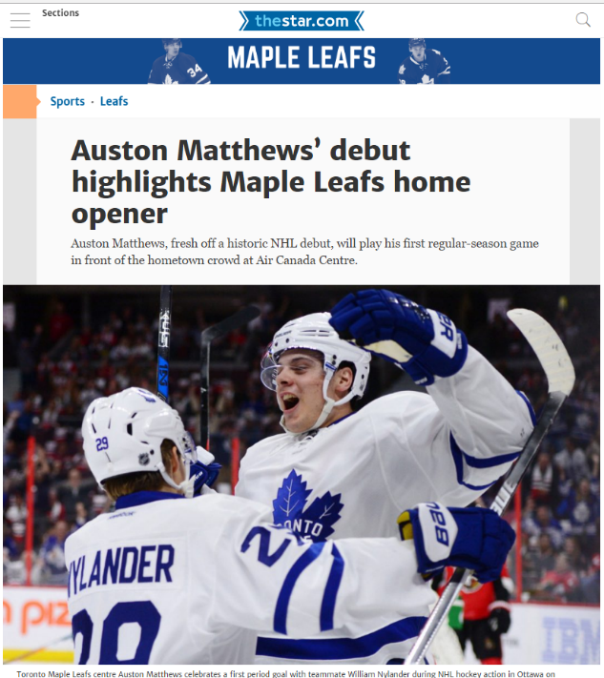
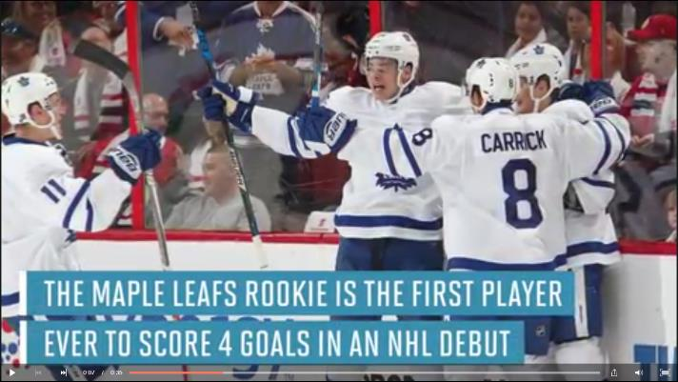
Youth Movement
10.12.2016 – Auston Matthews – Age 19
First player to score 4 goals in NHL Debut
#1 Draft Choice - 2016
https://www.nhl.com/news/auston-matthews-scores-in-first-nhl-game/c-282598312
Notes:
https://www.thestar.com/sports/leafs/2016/10/15/auston-matthews-debut-highlights-maple-leafs-home-opener.html
http://www.si.com/nhl/2016/10/12/auston-matthews-four-goals-nhl-debut-maple-leafs

Slide 41




2016-2017
Game 1: 4 goals Games 2-25: 7 goals
Notes:
https://www.hockey-reference.com/players/m/matthau01.html
oiSH% - on ice shooting %
oiSV% - on ice save %
PDO – sum of the two
https://sinbin.vegas/tag/oish/

Slide 42

https://www.hockey-reference.com/play-index/ppbp_finder.cgi
http://www.hockey-reference.com/
Notes:
http://www.hockey-reference.com/

Slide 43


Slide 44

2018-2019 Advanced/Possession Stats
Top 20: CAR (8), SJ (4)
Notes:
Carolina players – team reached playoffs for first time since 2009 and made it to the Conf. Finals (0-4 vs. Boston). SJ lost to STL in Wconf Finals. STL 4-3 over Boston in Stanley Cup Finals
https://www.hockey-reference.com/play-index/ppbp_finder.cgi?request=1&match=single&year_min=2018&year_max=2018&season_start=1&season_end=-1&rookie=N&age_min=0&age_max=99&pos=S&situation_id=ev&order_by=games_played

Slide 45

2017-2018 Reg. Season Stats
Notes:
https://www.hockey-reference.com/analytics/

Slide 46

2017-2018 Playoff Stats
http://puckon.net/corsi.php?s=2018-03-01&e=2018-07-01&f=0&ld=1&l=82&p=2
Notes:
http://puckon.net/corsi.php?s=2018-03-01&e=2018-07-01&f=0&ld=1&l=82&p=2

Slide 47

Adjustments to Corsi-Fenwick
Notes:
http://puckon.net/articles/introduction.php

Slide 48

http://www.hockeyabstract.com/playerusagecharts
Notes:
http://www.hockeyabstract.com/playerusagecharts

Slide 49
Breakout - http://www.hockeyabstract.com/playerusagecharts 2021-2022 season
WSH: Andrew Levy, Cole Beeker, David Goforth
PHI: Suyash Shrivastava, Elias Moreno Suarez, Victor Gregory
PIT: Josephine Yang, Harshit Aggarwal, Yasir Mohammad
TB: Victoria Abel, Ross Mouritzen, Quentin Alleyne
DAL: Daniel Dodson-Castillon, Zaurez Hamid
NYI: Akarsh Bychapura Ashok, Lujain Kashgari, Ben Greer
VGK: Justin Sherman, David Herman
COL: Ignacio Sanchez, Victor Juarez Becerril
SJ: Sun Pil Howang, Youssef Ragab
BOS: Zachary Zobell, Lawrence Brown
Notes:
Spend 3-5 mins analyzing team assigned to; walk through highlights

Slide 50


https://www.capfriendly.com/cost-per-point

Slide 51



Game Stats
http://hockeystats.ca/game/2017020360
{Defunct site}
Notes:
http://hockeystats.ca/game/2017020360

Slide 52

http://hockeystats.ca/game/2017020360
{Defunct site}

Slide 53


http://naturalstattrick.com/game.php?season=20172018&game=20360

Slide 54

https://www.sportingcharts.com/nhl/icetrack/ - site no longer exists
Notes:
https://www.sportingcharts.com/nhl/icetrack/

Slide 55


Slide 56


Fighting Stats
INST – Instigator | ATBF – Avg Time b/t Fights
Notes:
http://www.espn.com/nhl/statistics/player/_/stat/major-penalties/sort/fightingPenalties/year/2017

Slide 57


A look at the decline of fighting and extinction of the NHL enforcer
Notes:
http://www.sportsnet.ca/hockey/nhl/a-look-at-the-decline-of-fighting-and-extinction-of-the-nhl-enforcer/

